Slide 1
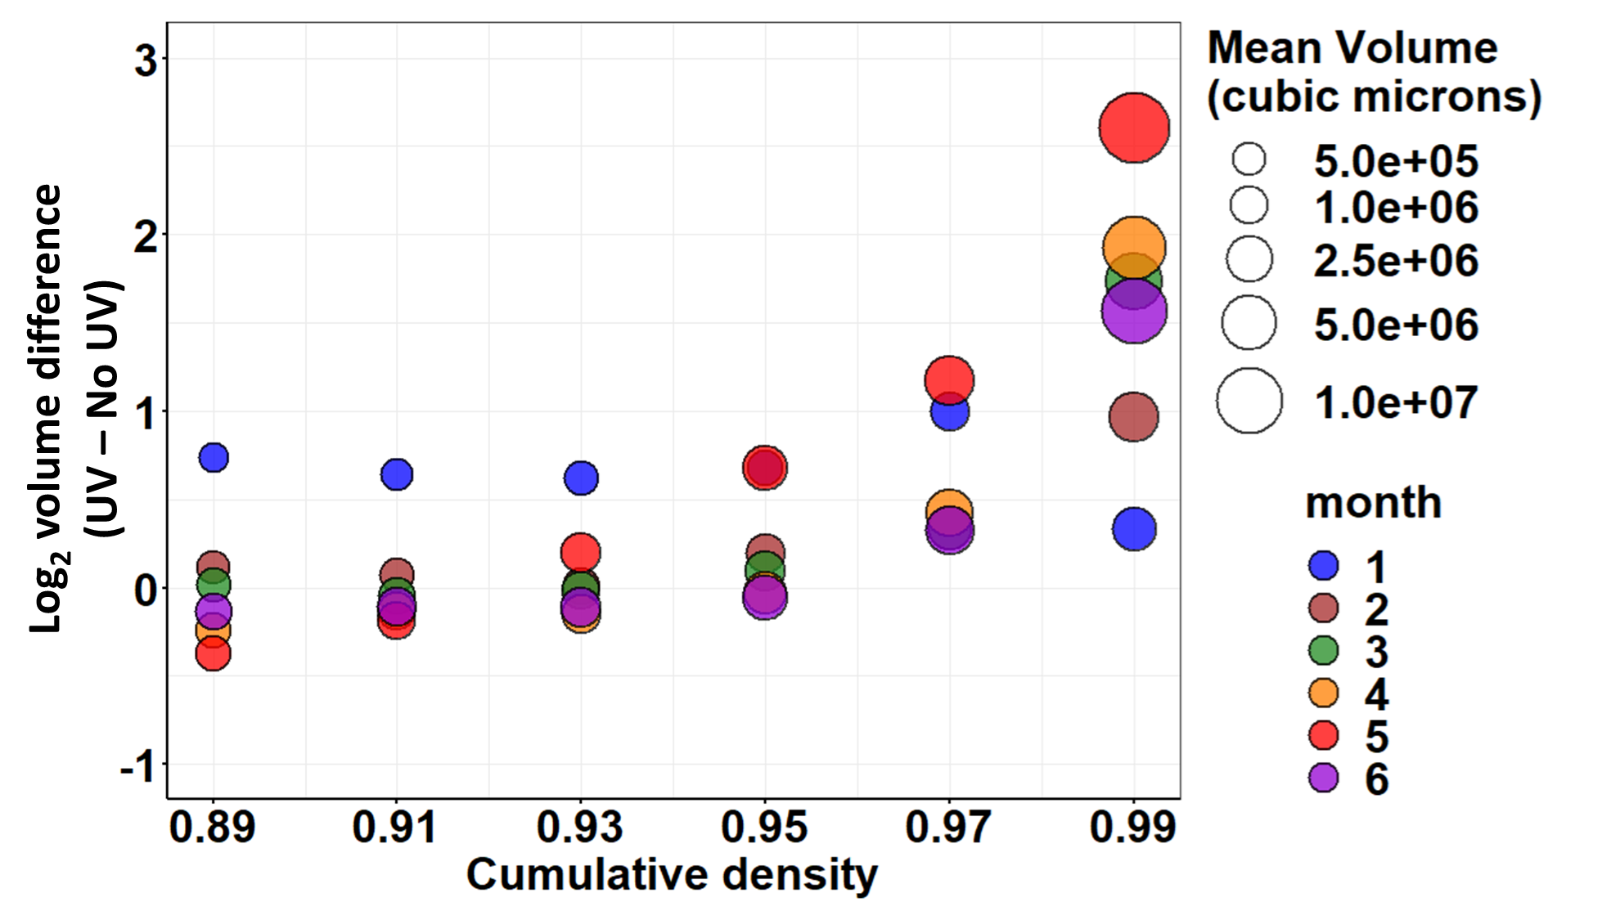

Slide 2
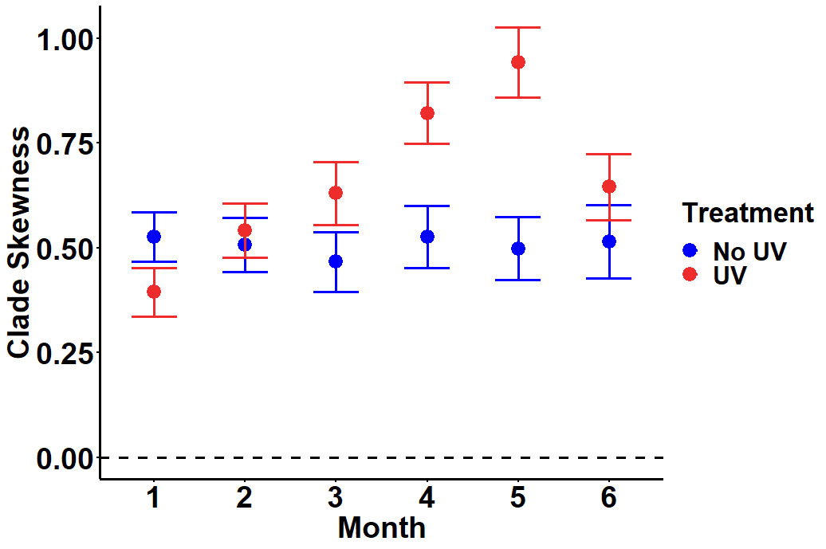
This is with corrected data

Slide 3
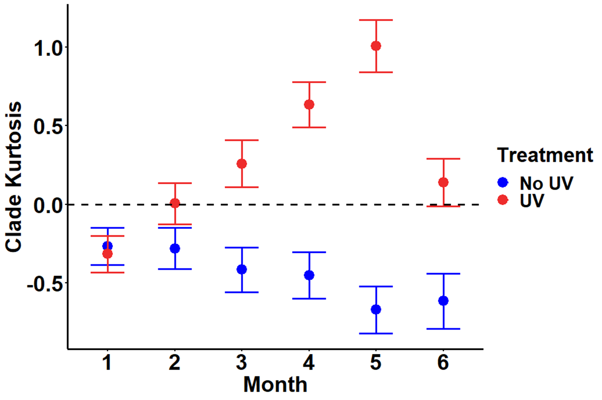
This is with corrected data

Slide 4
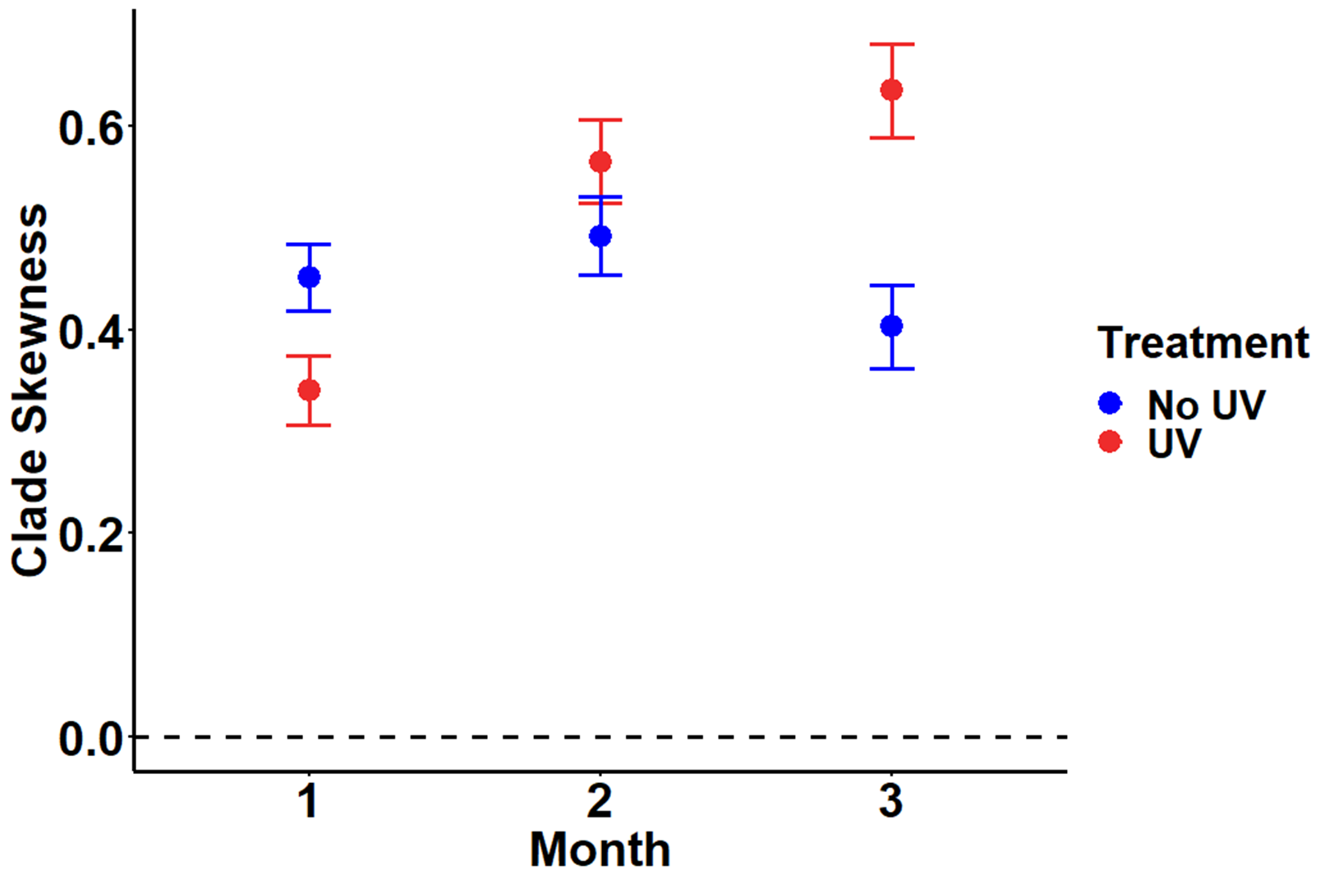
This is with corrected data

Slide 5
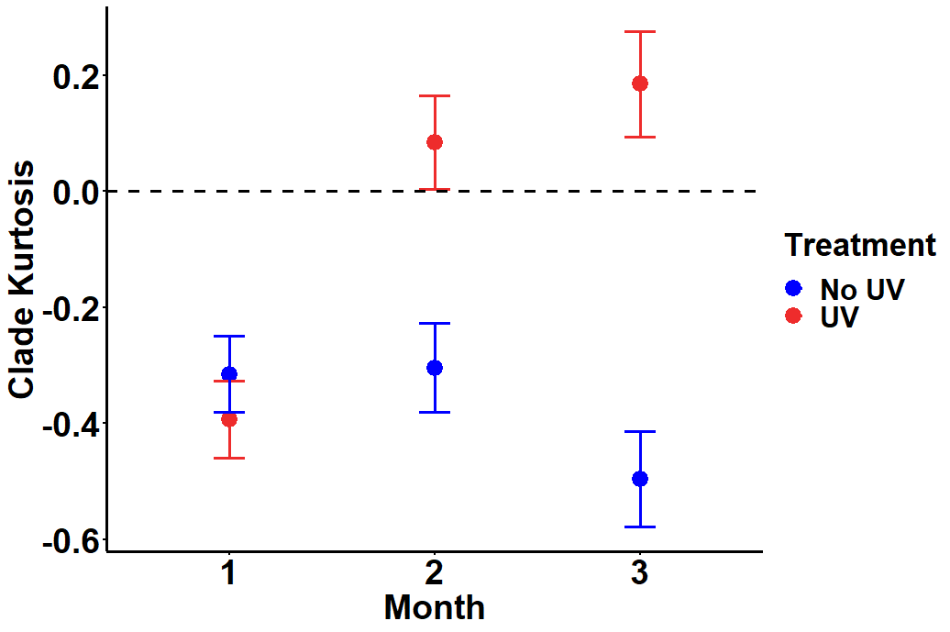
This is with corrected data

Slide 6
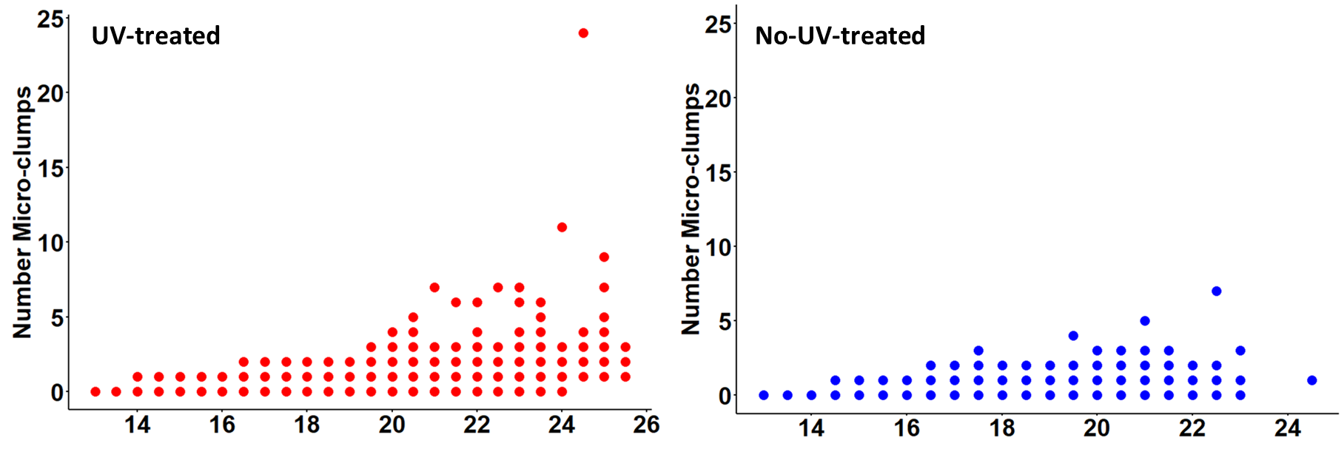
This is with corrected data (graph components combined)
Clade volume (log₂(μm³))

Slide 7
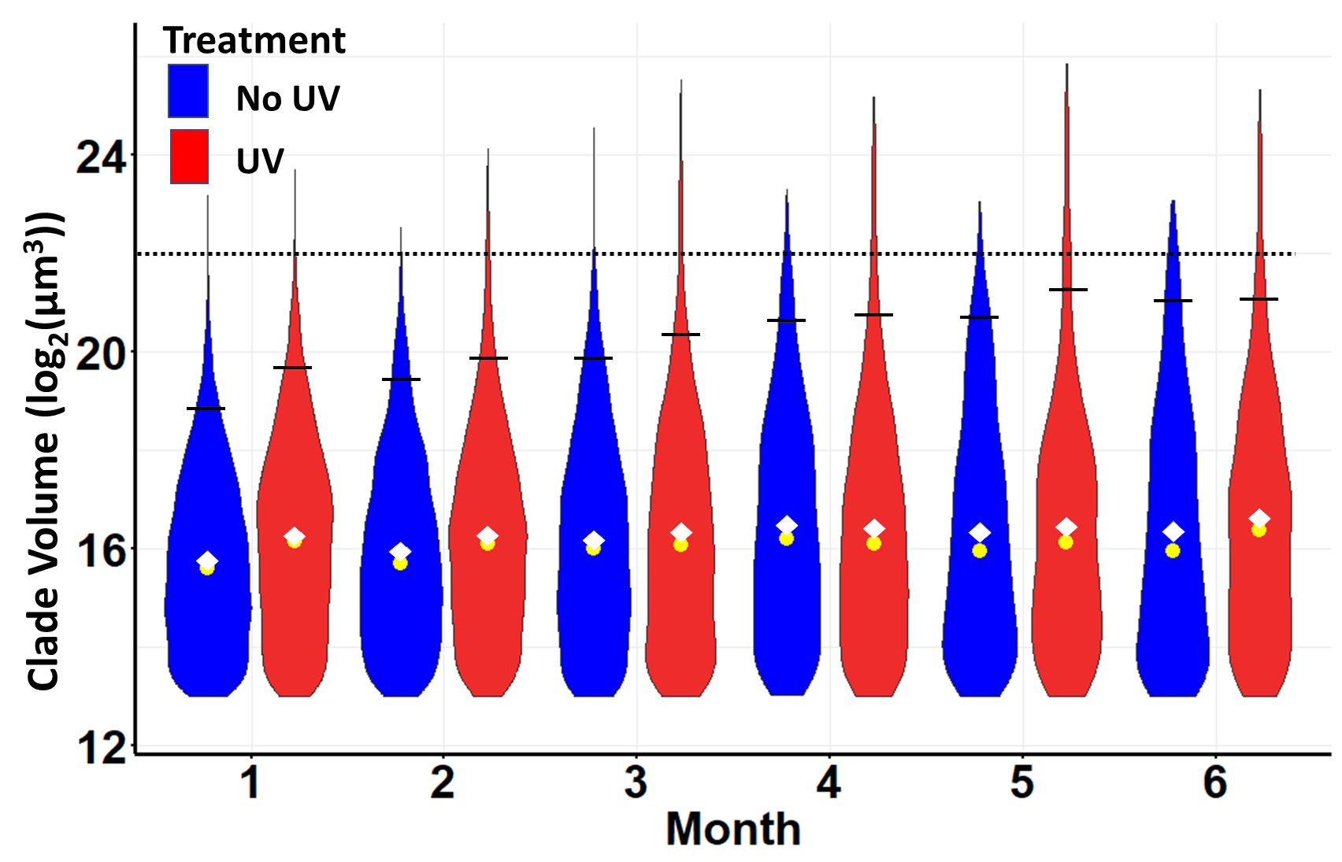

Slide 8
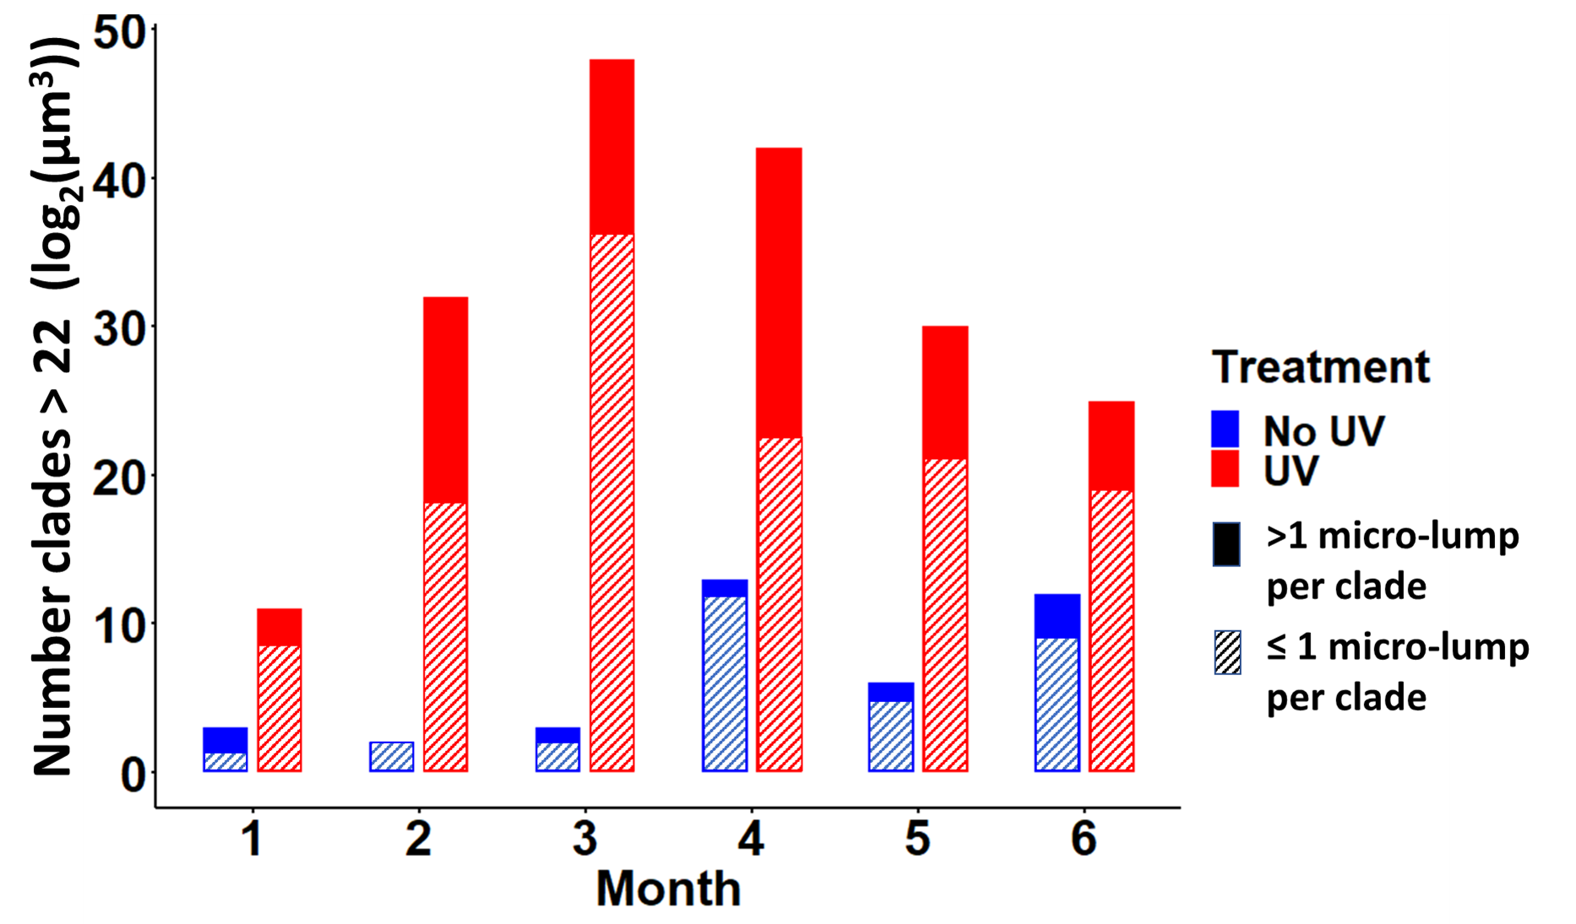

Slide 9
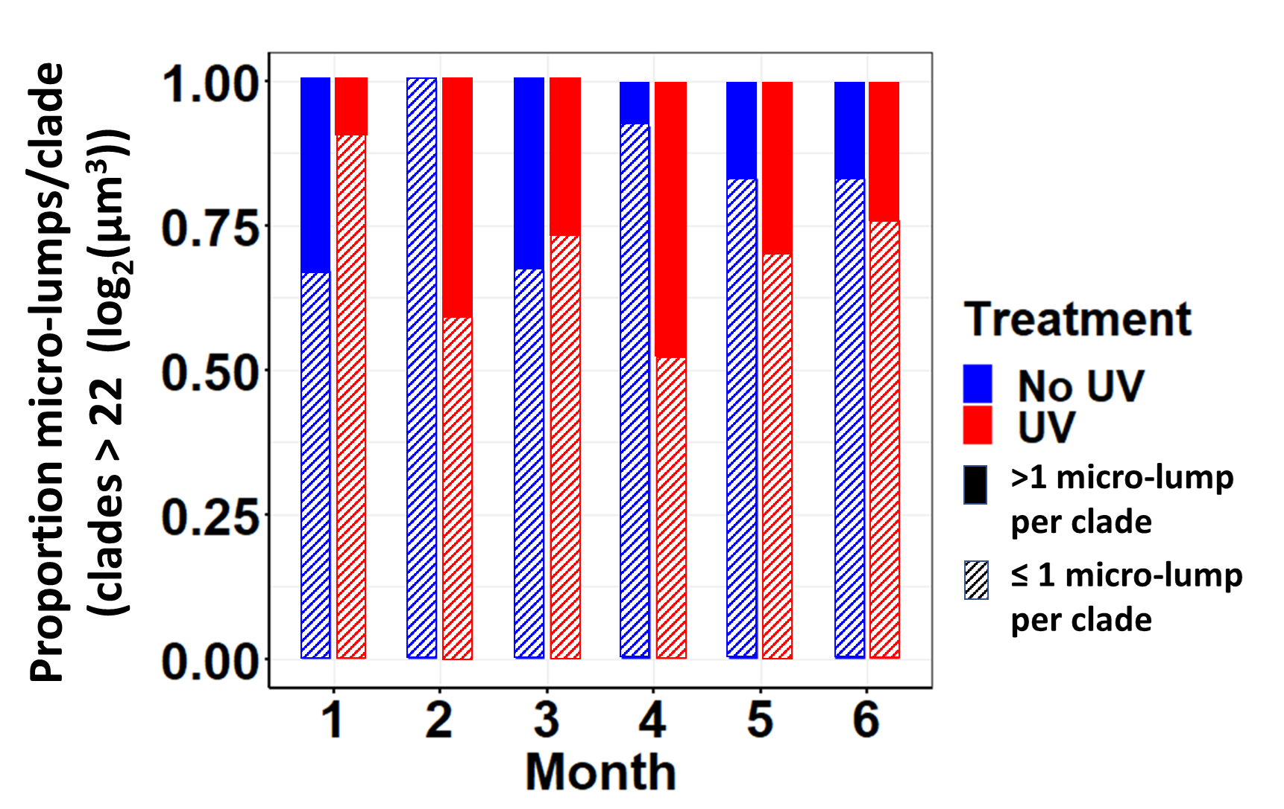

Slide 10
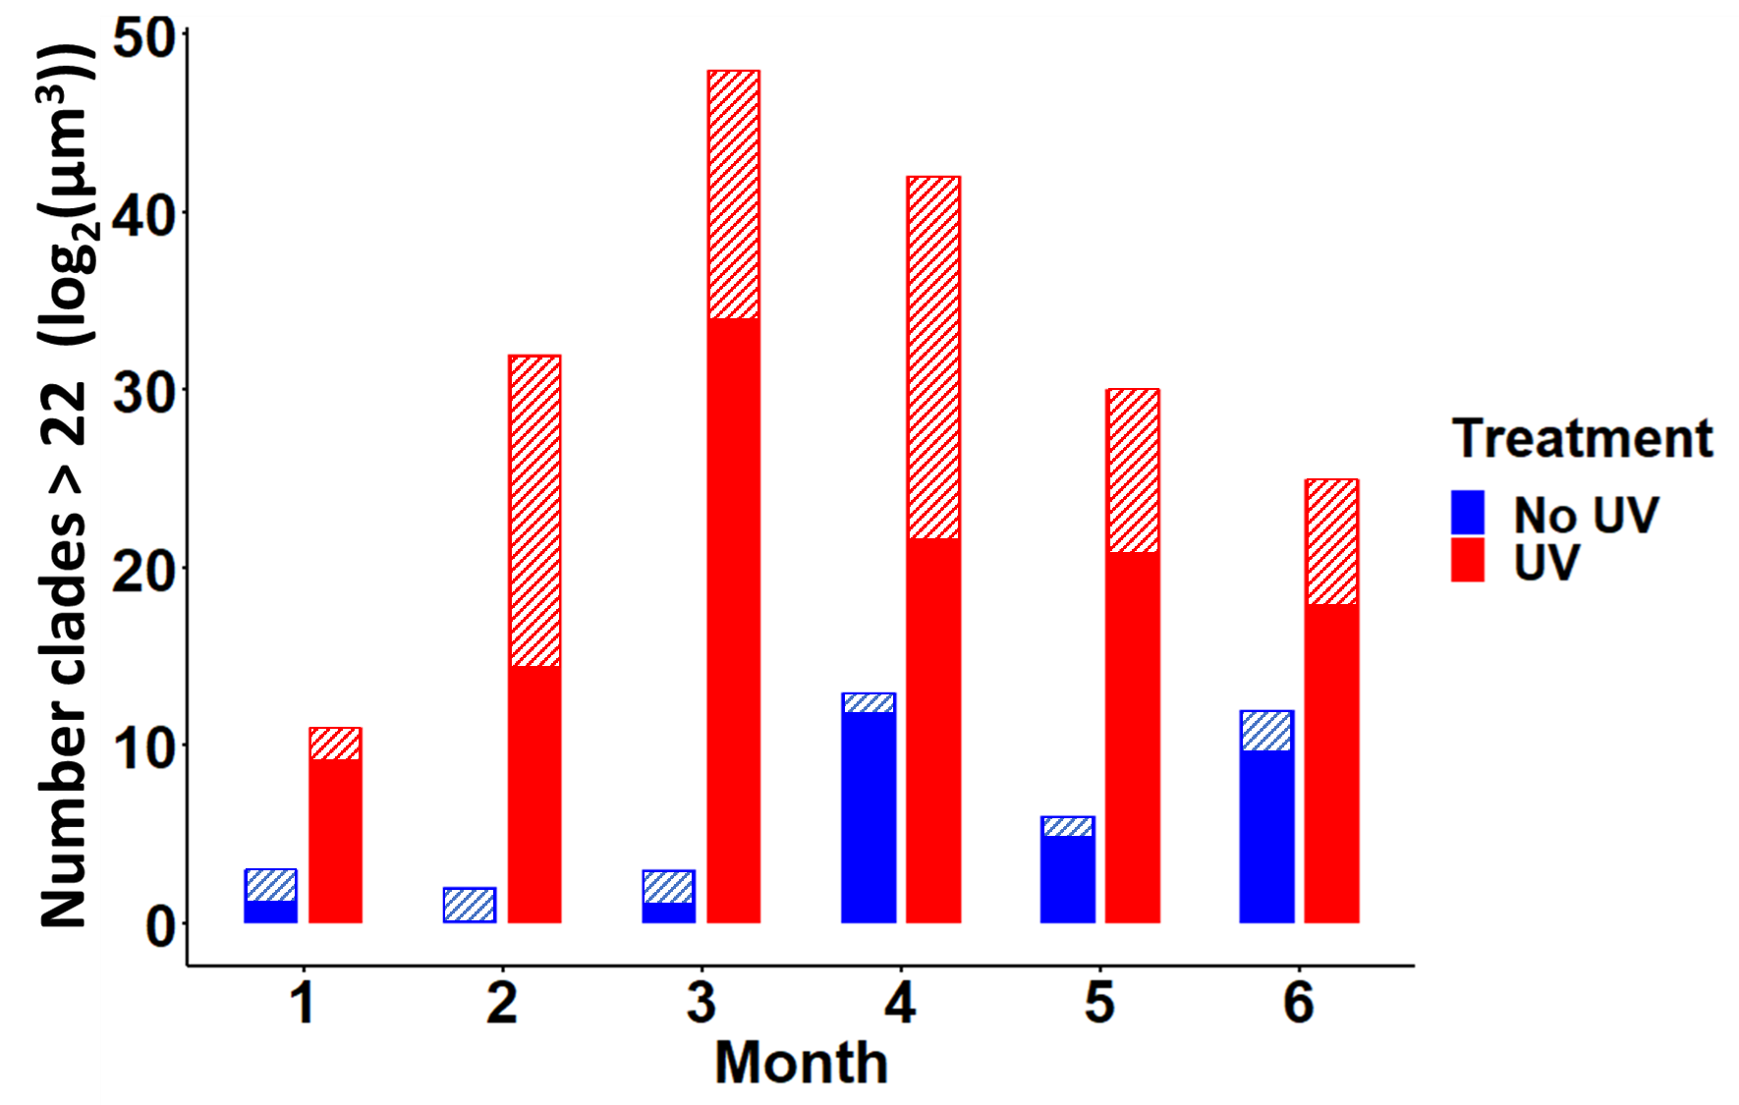

Slide 11
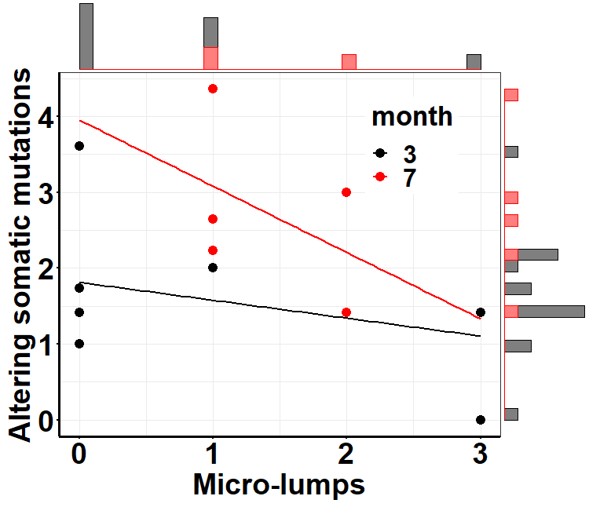
This is with correct data
No-UV-treated

Slide 12
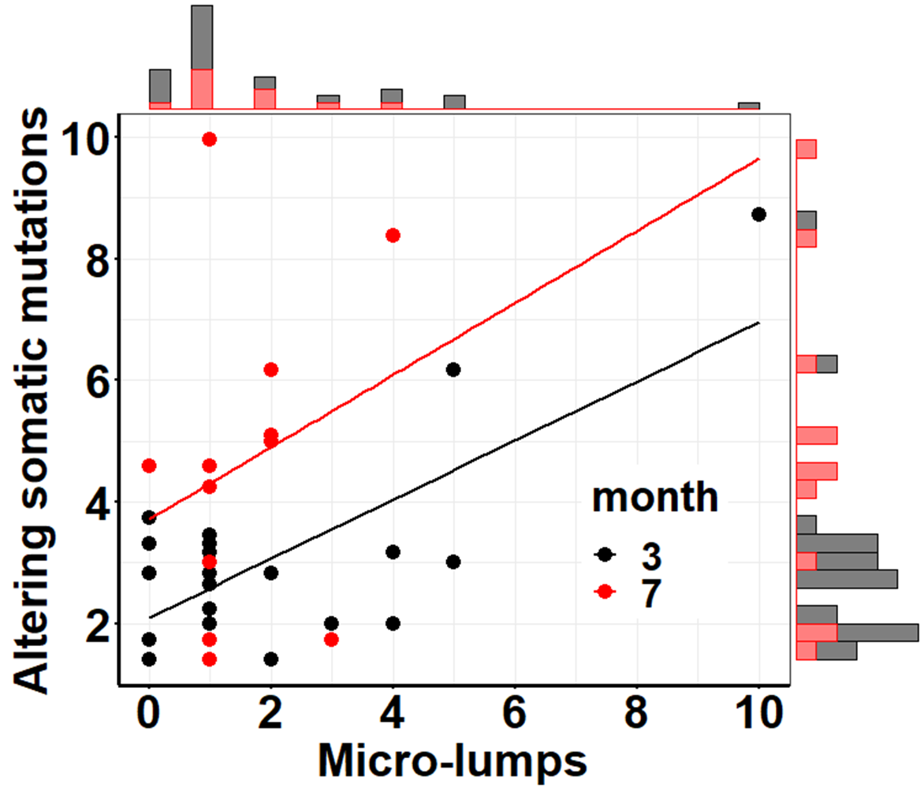
This is with correct data
UV-treated

Slide 13
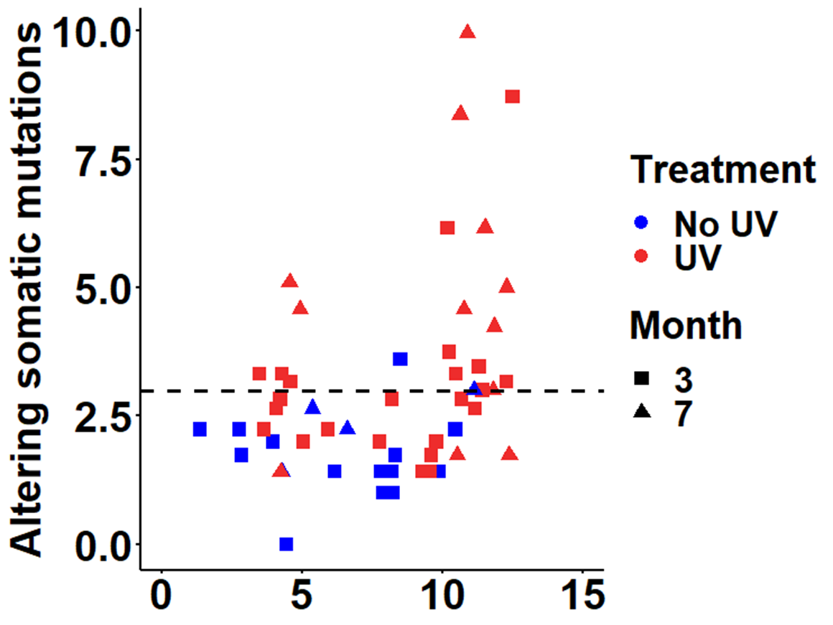

Slide 14
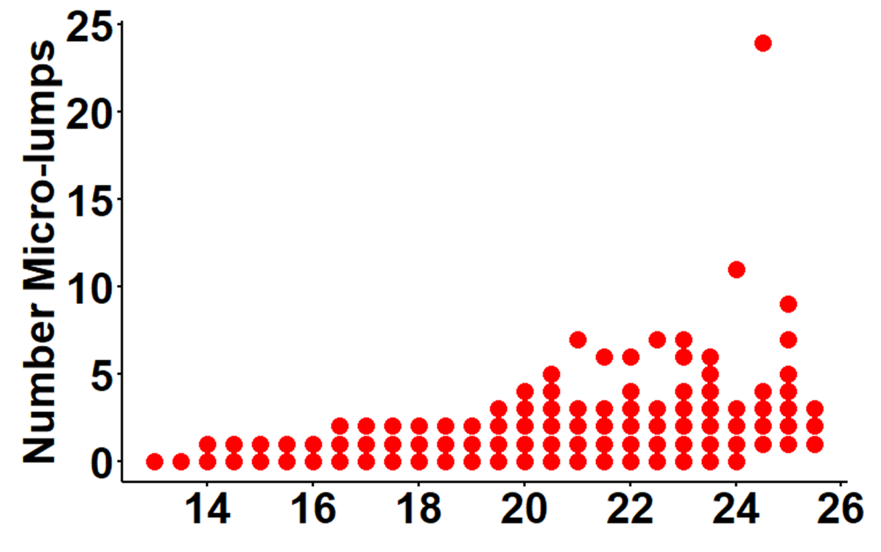

Slide 15
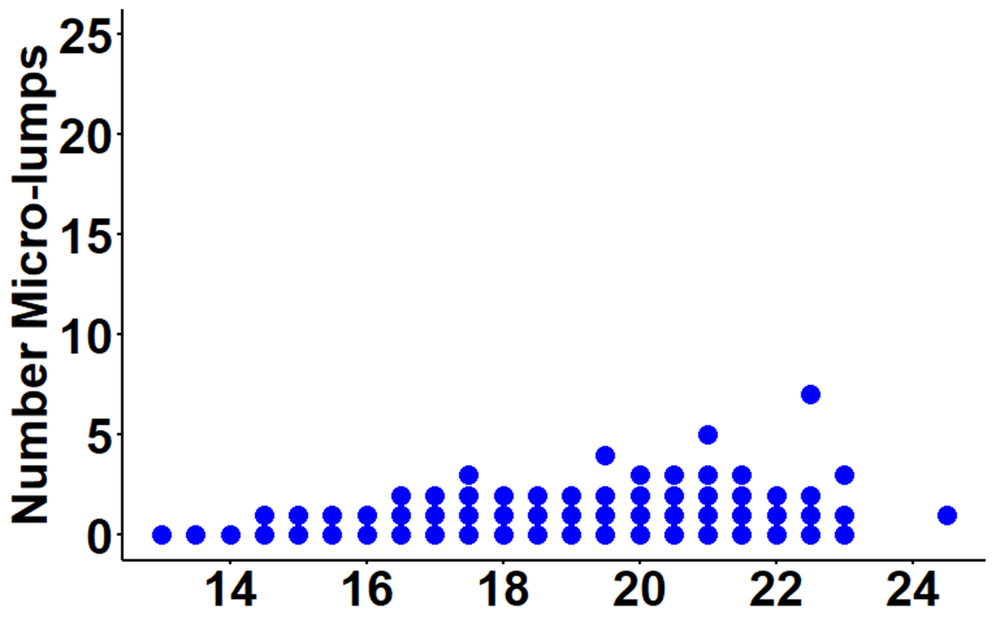

Slide 16
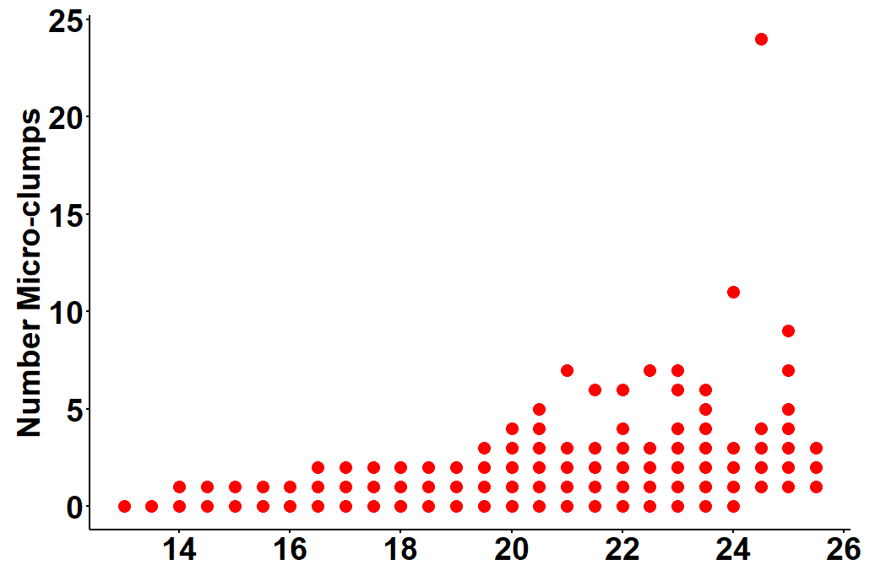
UV-treated
This is with corrected data
Clade volume (log₂(μm³))

Slide 17
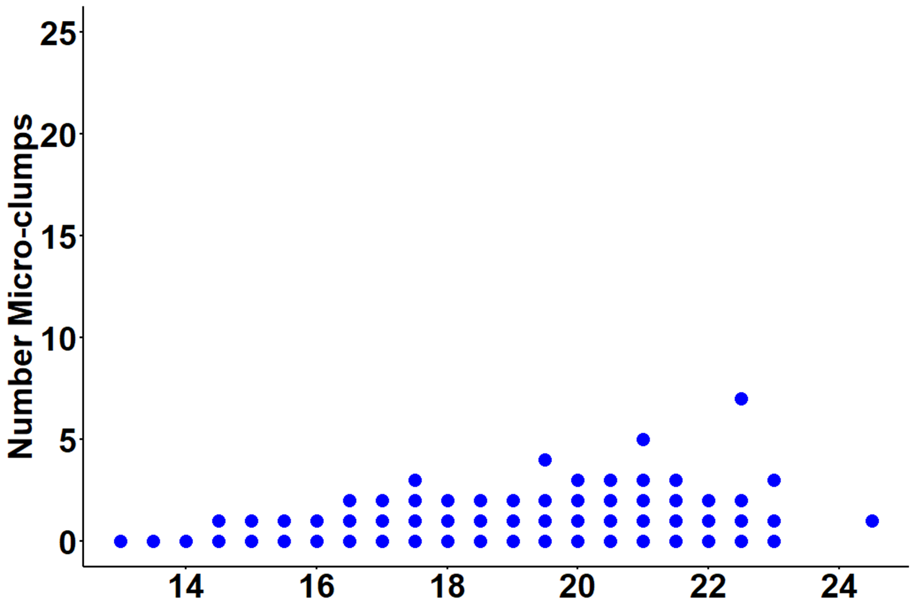
This is with corrected data
No-UV-treated
Clade volume (log₂(μm³))

Slide 18


This is with corrected data (all figure components are separate
UV-treated
No-UV-treated
Clade volume (log₂(μm³))

Slide 19
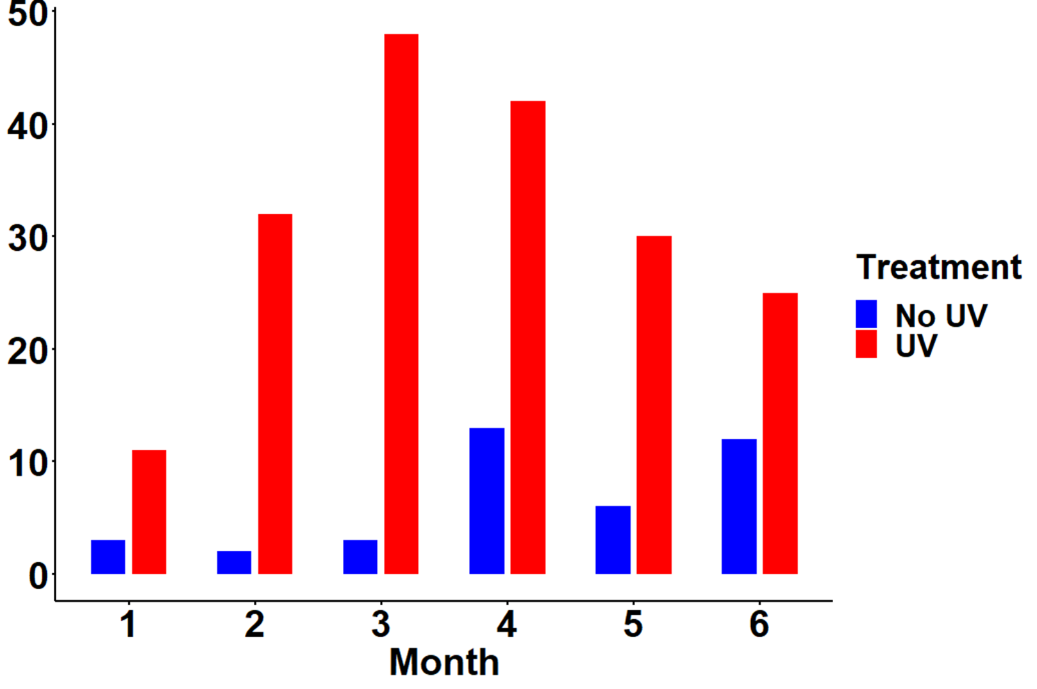
Treatment
Number clades > 22 (log₂(μm³))
Month

Slide 20
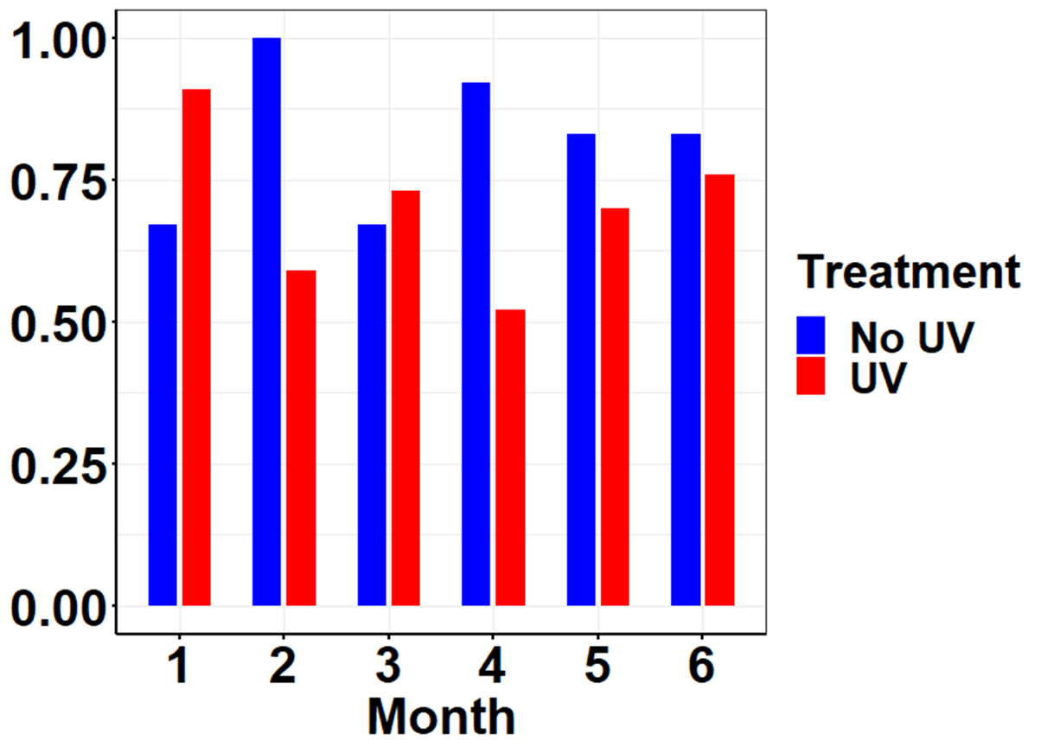
Proportion micro-lumps/clade
(clades > 22 (log₂(μm³))
>1 micro-lump
per clade
≤ 1 micro-lump
per clade

Slide 21
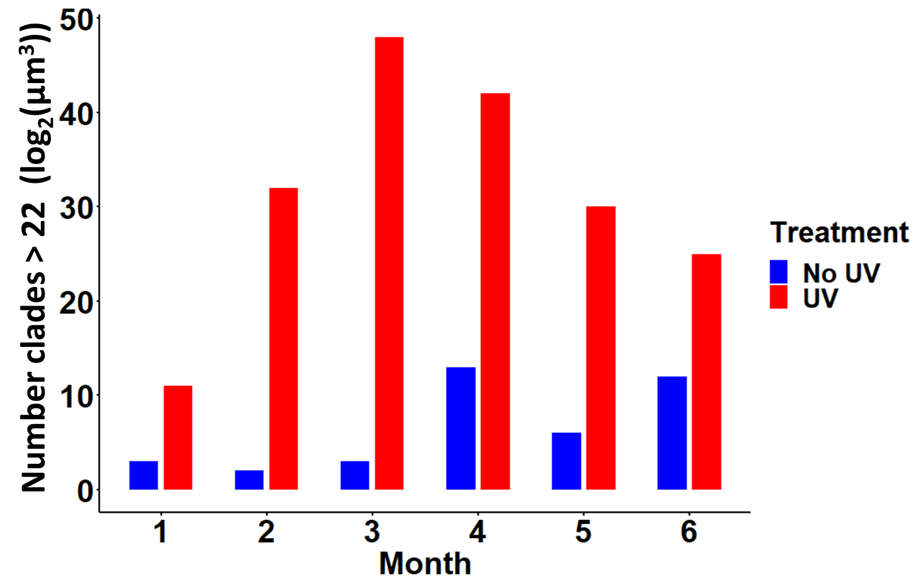

Slide 22
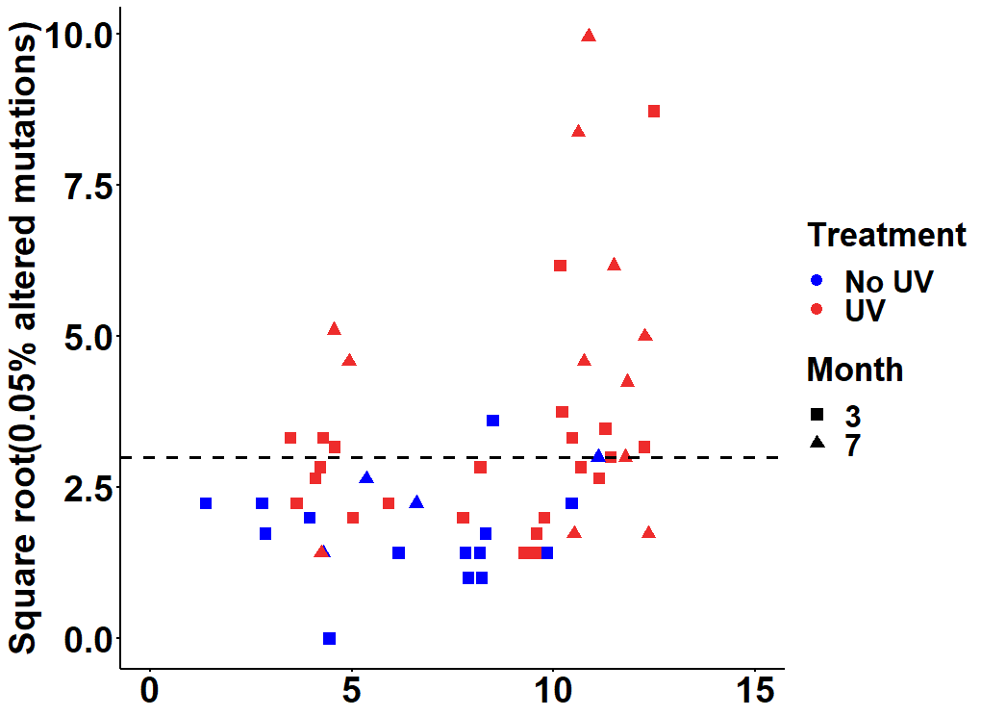
Clade volume (log₂(μm³))

Slide 23
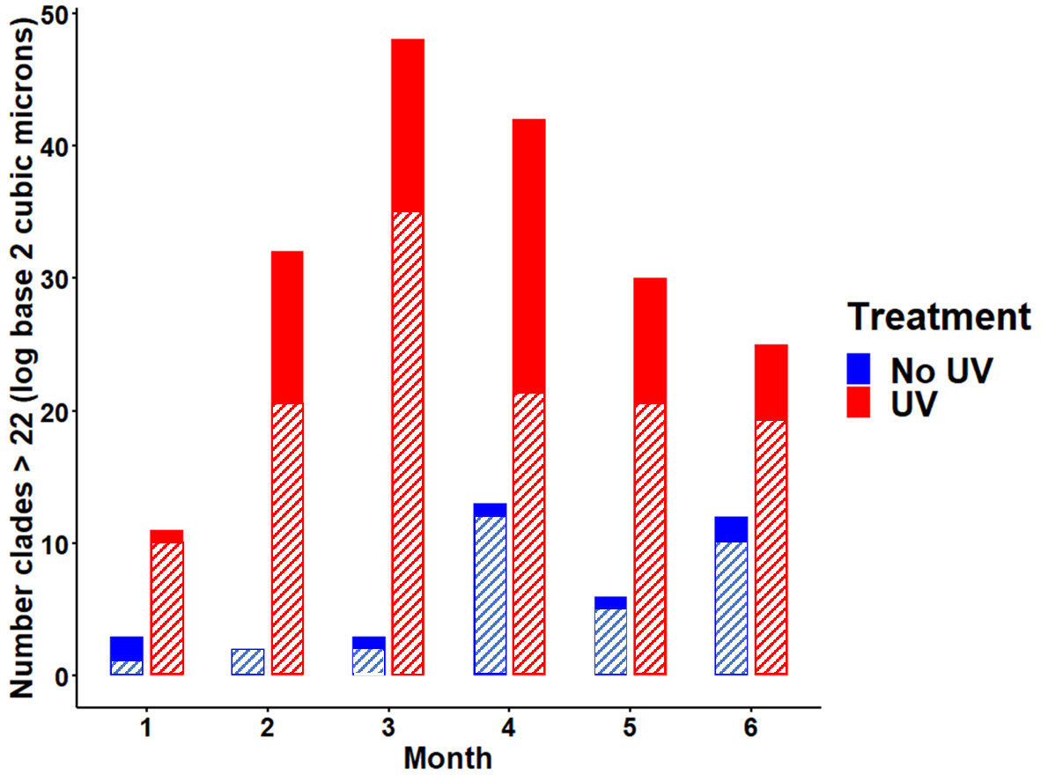

Slide 24
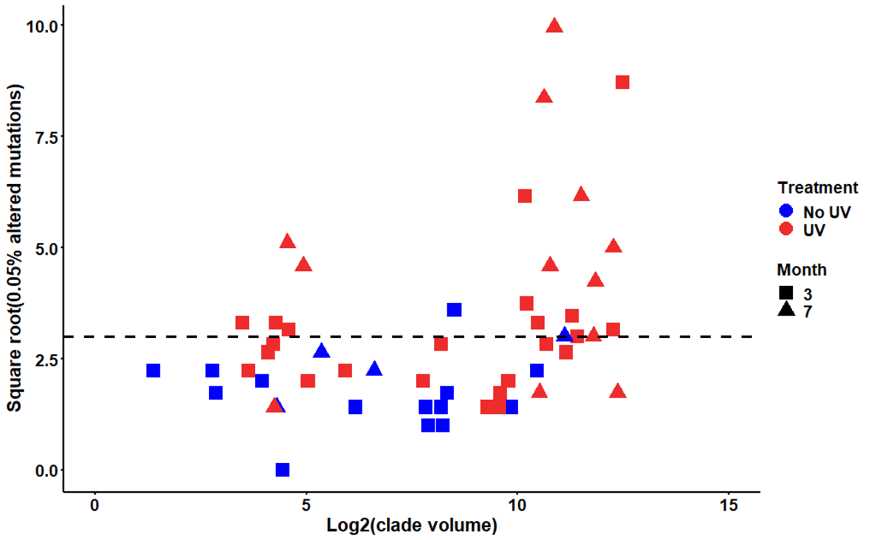
This is with correct data

Slide 25
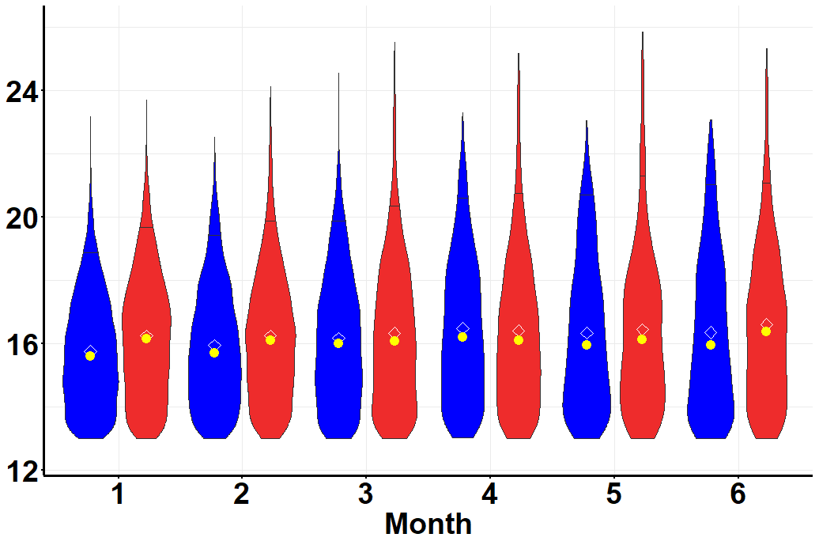
Treatment
No UV
UV
Clade Volume (log₂(μm³))

Slide 26
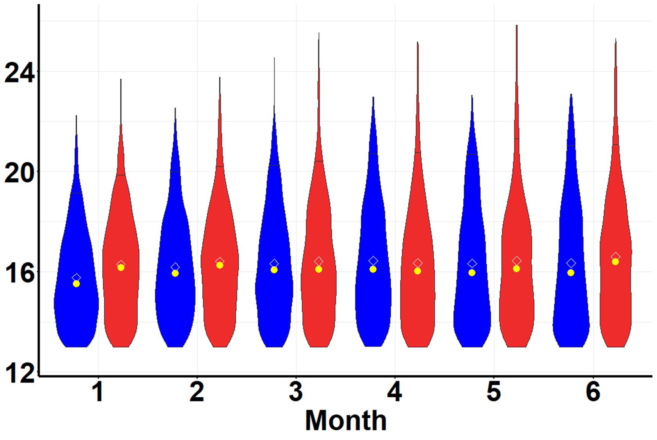

Slide 27
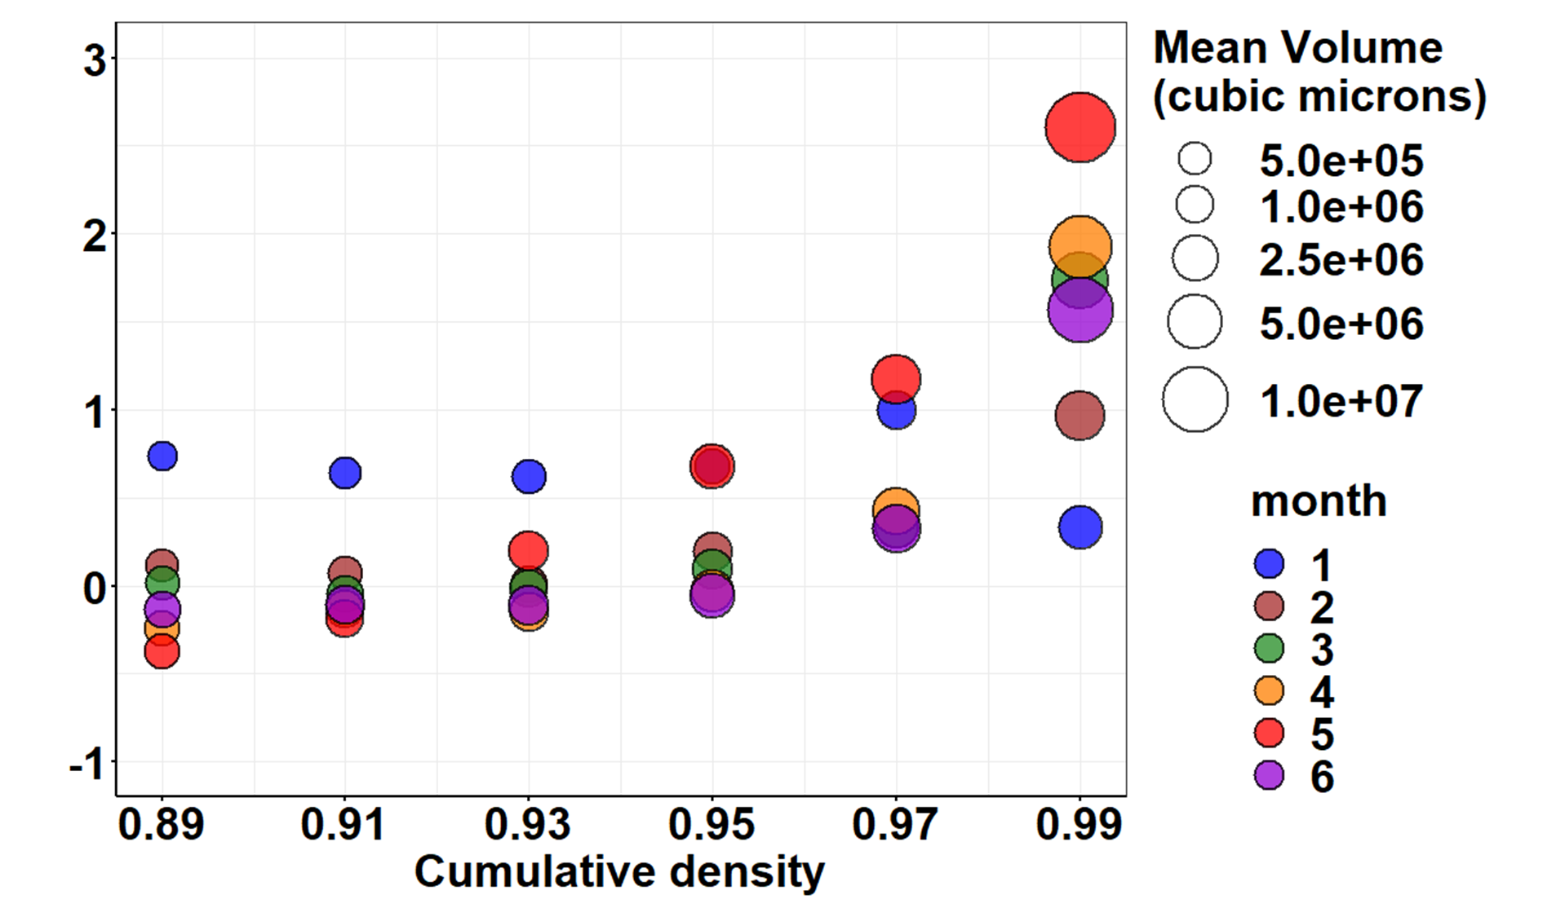

Slide 28

Log₂ volume difference
(UV – No UV)

Slide 29
No UV
UV
Log₂ volume difference
(UV – No UV)
Clade Volume (log₂(μm³))
Number clades > 22 (log₂(μm³))
Clade volume (log₂(μm³))
> 1 micro-lump per clade
≤ 1 micro-lump per clade

